Slide 1
An Electric Craving
UCSD Data Science and Programming Bootcamp
Project One
Jacob Zacarias
Sanabu Washizuka
Tanlin Hung
Walaa Alani

Slide 2
Introduction
"Todd"
Lives in San Diego, CA
Enjoys rock climbing
A foodie
Looking to buy a new car
(FIND CLIPART/DRAWING/PHOTO OF RANDOM GUY AND INSERT HERE. ENSURE THE ART IS FREE USE.)

Slide 3
Theme of the Study
Should I get an electric vehicle over a gas-powered car?

Slide 4
EV or Gas Car?
Q1. Will I be able to find charging stations wherever I am?
Q2. Out of both categories (EVs and gas-powered cars) which make and model is the most cost-effective for their fuel?
Q3. Will EVs really pay themselves off?
Q4. What factors might hint that a city has a lot of charging stations?
Q5. How much will I save on a trip?

Slide 5
Brief Summary of findings
Q1. Will I be able to find charging stations wherever I am?
(summary here?)
Q2. Out of both categories (EVs and gas-powered cars) which make and model is the most cost-effective for their fuel?
(summary here?)
Q3. Will EVs really pay themselves off?
(summary here?)
Q4. What factors might hint that a city has a lot of charging stations?
(summary here?)
Q5. How much will I save on a trip?
(summary here?)

Slide 6
Q.4 What factors might hint that a city has plentiful charging stations?
"If I were to move or travel elsewhere, what factors could I look at to see how reliably I can find a charge station?"
In other words, what properties of a city correlates with how many charge stations are available there?

Slide 7
Q.4 Correlational Study
Correlational Study of the "No. of Charge Stations" against other factors within a city
Review "No. of Charge Stations" against :
City Population Density
Gas Prices (CA only study)
Institution type 1 (to be named later)
Institution type 2 (to be named later)

Slide 8
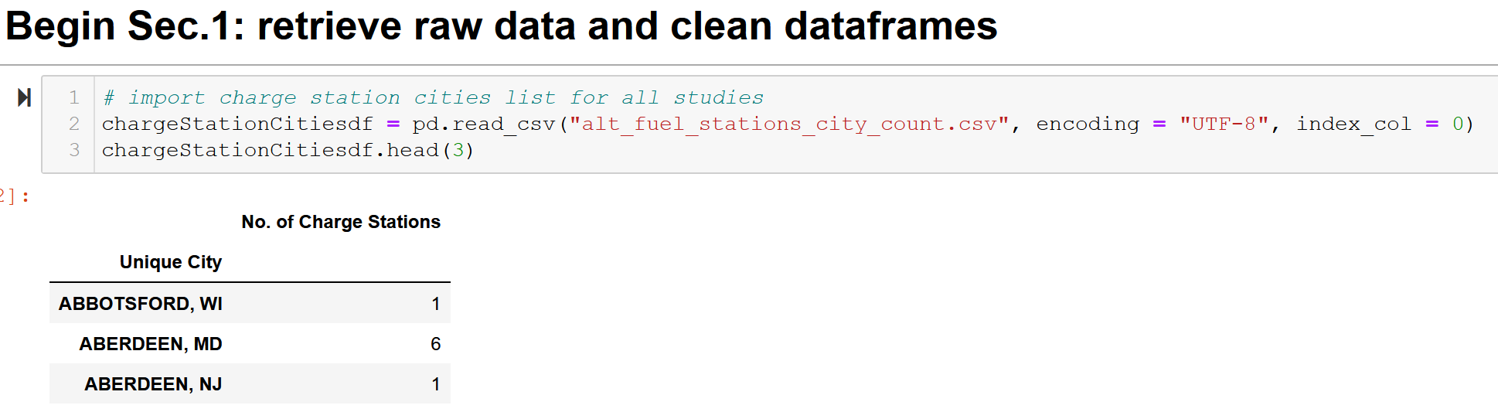
Q.4.1 – Charging Station List

Slide 9
Q.4.1 - City List and City Population Density (cleaning)
Source:
https://simplemaps.com/data/us-cities
General Info:
Information on cities in the U.S.
Updated as of November 18, 2020
Over 108,000 cities and towns from all 50 states
Population Density per city

Slide 10
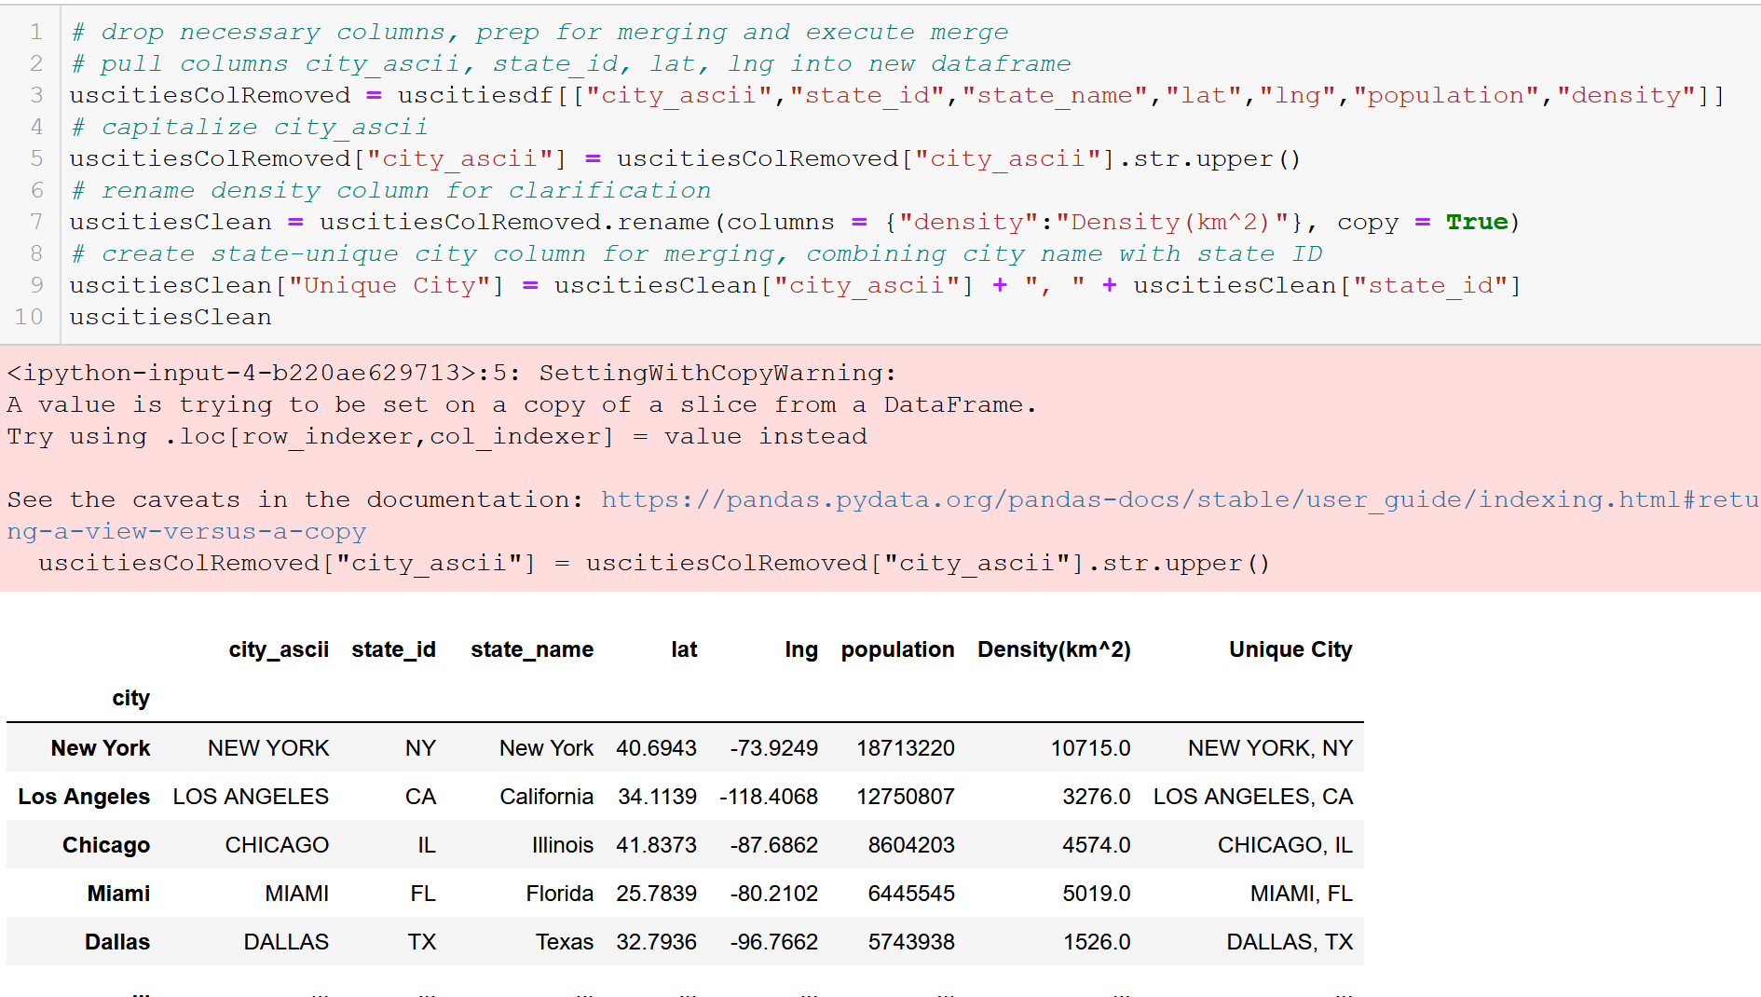
Q.4.1 - City List and City Population Density (cleaning)
*Note line 9

Slide 11
Q.4.1 – Urban Areas (cleaning)
Source:
https://en.wikipedia.org/wiki/List_of_United_States_urban_areas
General Info:
A list of urban areas in the United States as defined by the United States Census Bureau
An urbanized area (UA) is an urban area with population over 50,000
Used to limit cities to observe for API call

Slide 12
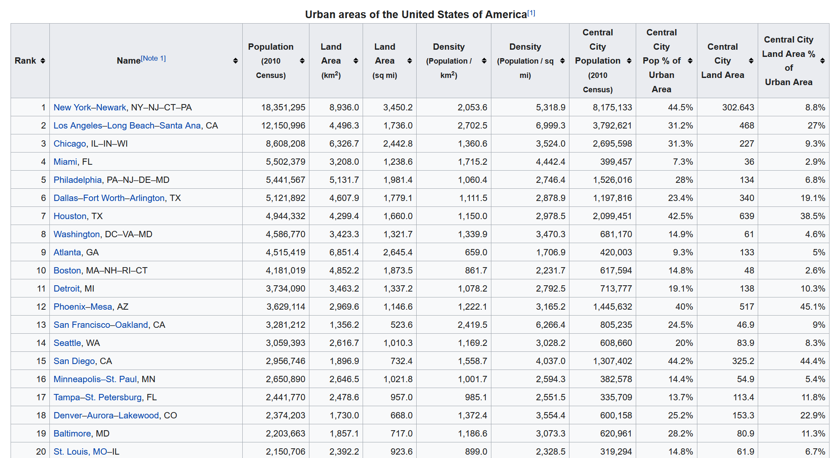
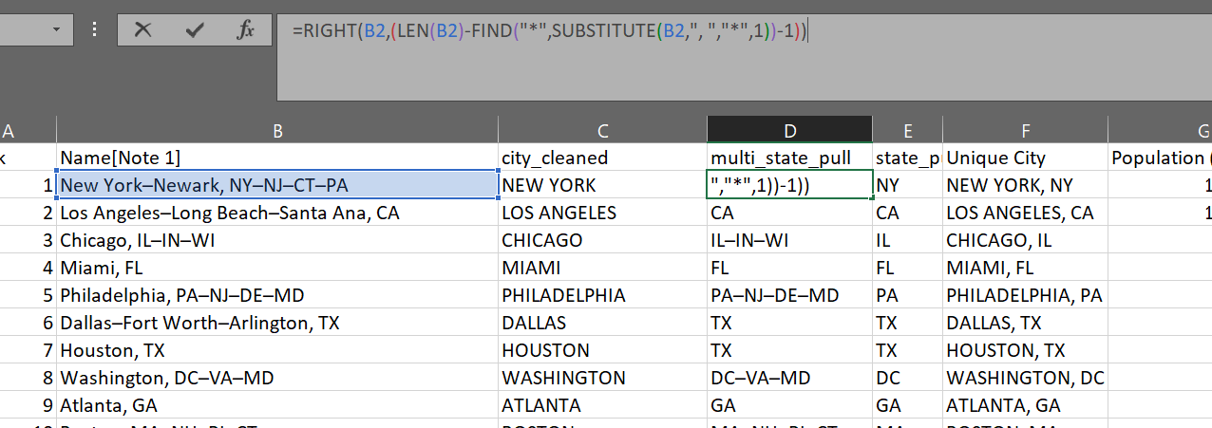
Q.4.1 - City List and City Population Density (cleaning)
Creating state-unique city names within Excel for merging

Slide 13
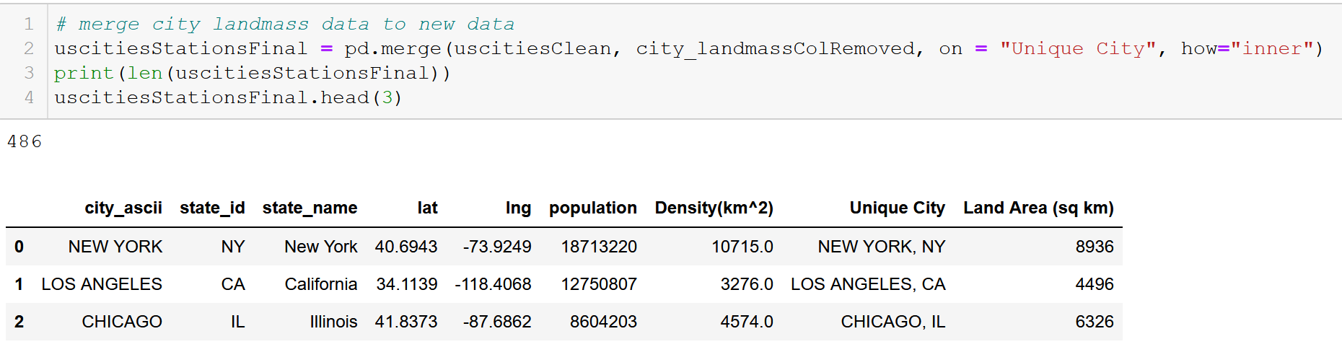
Q.4.1 – Merge to limit city count

Slide 14
An Electric Craving
UCSD Data Science and Programming Bootcamp
Project One
Jacob Zacarias
Sanabu Washizuka
Tanlin Hung
Walaa Alani

Slide 15
Topic Slide
CONTENT HERE

Slide 16
Subtitle
CONTENT HERE

